Slide 1
DONATING BLOOD
WHY IS IT IMPORTANT FOR ME TO DONATE BLOOD?
WHY SHOULD YOU DONATE BLOOD ?
BENEFITS OF DONATING BLOOD.
WHO CAN OR CAN´T GIVE BLOOD.
TYPES OF PEOPLE YOUR BLOOD CAN HELP.
HOW MUCH BLOOD DOES IT TAKE TO SAVE A LIFE?
BLOOD TYPES.

Slide 2
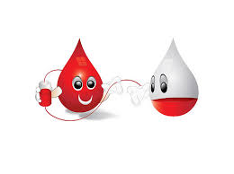
WHY IS IT IMPORTANT FOR ME TO DONATE BLOOD ?
YOU MAY SAVE THE LIVES OF PEOPLE IN NEED. THERE ARE A LOT OF PEOPLE IN NEED OF BLOOD EVERY DAY.
BLOOD ONLY COMES FROM GENEROUS DONORS. DONATION IS THE ONLY WAY OF OBTAINING BLOOD. BLOOD IS NOT MANUFACTURED. DESPITE ALL THE MEDICAL AND TECHNOLOGICAL ADVANCES,BLOOD CANNOT BE CURRENTLY MADE .THERE IS NO SUBSTITUTE FOR BLOOD.

Slide 3
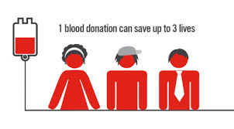
WHY IS IT IMPORTANT FOR ME TO DONATE BLOOD ?
EACH DONATION MAY HELP UP TO THREE DIFFERENT PEOPLE.
EACH DONATION PROVIDES THREE DIFFERENT BLOOD COMPONENTS(RED BLOOD CELLS,PLASMA AND PATELETS),EACH WITH ITS OWN ROLE IN TREATING PATIENTS.
BLOOD AND ITS COMPONENTS HAVE A LIMITED LIFE:
RED BLOOD CELLS CAN BE KEPT FOR ONLY 42 DAYS.
PLASMA CAN BE STORED FOR A YEAR
PATELETS CAN BE KEPT FOR 5 DAYS.

Slide 4
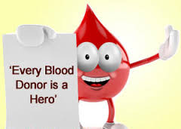
WHY SHOULD I DONATE BLOOD?
YOU DON´T NEED A SPECIAL REASON.YOU JUST NEED YOUR OWN REASON.
SOME OF US GIVE BLOOD BECAUSE WE WERE ASKED BY A FRIEND.
SOME OF US KNOW THAT A FAMILY MEMBER OR A FRIEND MIGHT NEED BLOOD SOME DAY.
SOME BELIEVE IT IS THE RIGHT THING TO DO.
WHATEVER YOUR REASON,THE NEED IS CONSTANT AND YOUR CONTRIBUTION IS IMPORTANT FOR A HEALTHY AND RELIABLE BLOOD SUPPLY.

Slide 5
BENEFITS OF BLOOD DONATION
YOU GET A FREE CHECK UP.
IT LOWERS THE RISK OF STROKE.
IT REDUCES THE CHANCES OF HEART ATTACK.
IT ENHANCES THE PRODUCTION OF RED BLOOD CELLS.
REDUCES THE RISK OF CANCER.
IT REDUCES CHOLESTEROL.
IT IMPROVES CIRCULATION.
IT PREVENTS IRON ACCUMULATION.
IT FEELS GREAT TO DONATE!.

Slide 6
YOU CAN /CAN´T DONATE BLOOD
CAN
IF YOU ARE FIT AND HEALTHY.
IF YOU ARE AGED 18 -70.
IF YOU WEIGH MORE THAT 45KG.
IF YOU´VE HAD NO OPERATION IN SIX MONTHS.
EVEN IF YOU HAVE CHOLESTEROL.
EVEN IF YOU TAKE BLOOD PRESSURE MEDICATION AND YOUR PRESSURE IS STABLE.
CAN´T
IF YOU HAVE A COLD,SORE THROAT OR FLU.
IF YOU KNOW YOU HAVE A CHRONIC INFECTIOUS DISEASE(AIDS..)
YOU ARE TAKING ANTIBIOTICS.
YOU´VE HAD RECENT SURGERY.
YOU´VE HAD A RECENT TATOO OR PIERCING.
YOU´VE HAD A VACCINATION IN THE LAST 24 HOURS
YOU ARE PREGNANT OR BREASTFEEDING.
YOU´VE HAD AN EXTENDED STAY IN CERTAIN COUNTRIES.

Slide 7
HOW MUCH BLOOD DOES IT TAKE TO SAVE A LIFE?
HIP REPLACEMENT SURGERY : 2 UNITS
APLASTIC ANEMIA :4 UNITS A MONTH
CANCER TREATMENT :5 UNITS
CARDIOVASCULAR TREATMENT :5 UNITS
LEUKEMIA :8 UNITS A WEEK
AUTO ACCIDENT : UP TO 50 UNITS

Slide 8
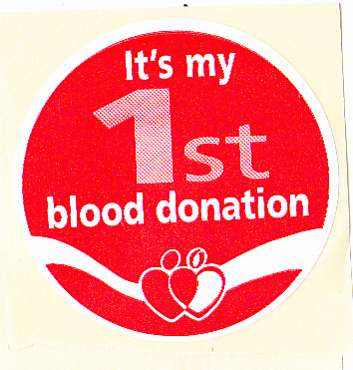
TYPE OF PEOPLE YOUR BLOOD CAN HELP
PEOPLE WITH LEUKEMIA.
PEOPLE WITH CANCER.
SURGICAL PATIENTS.
OPEN HEART SURGERY.
BRAIN SURGERY.
ROAD VICTIMS.
BURN VICTIMS.
PEOPLE WHO NEED TRANSPLANTS.
MOTHERS AFTER CHILDBIRTH.
PREMATURE BABIES.

Slide 9
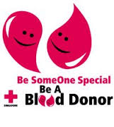
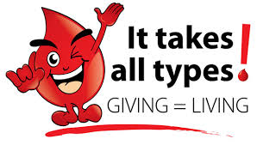
BLOOD TYPES

